Slide 1
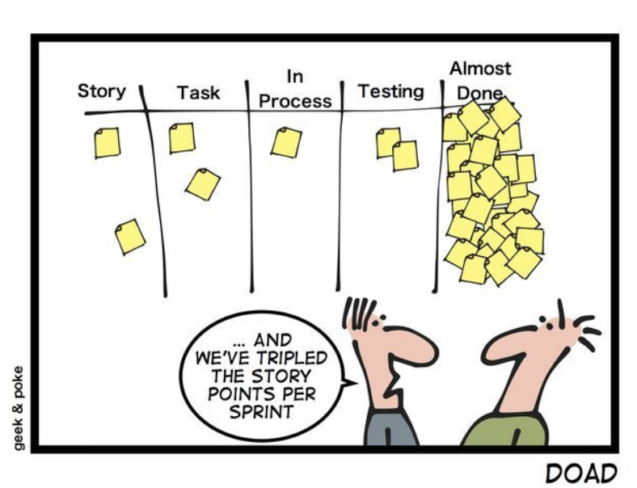

Agile
Multitasking
(v.) Screwing up several things at once.

Slide 2

Clean Code
“God is in the details”
- Ludwig mies van der Rohe

Slide 3

Why do I care
As some of you have noticed already writing code is hard and reading ( and truly understanding) code is just as hard.
Writing code involves investigation and analyses on the problems at hand.
Reading code involves identifying what the code is doing and then identifying issues.

Slide 4
Bad Code
I think you know what bad code is but just to hit a few points:
Buggy
Hard to read
Long lead time on fixes and updates
Long load times and crashes
No comments and poor function and variable names
Unorganized code

Slide 5
Why bad code
If we know what makes bad code bad, then why write bad code?
Rushing a product
Inconsistency from a programmer/developer
Becoming board of a program
Ie. Switching to other tasks in the “backlog” and not returning
A working mess is better than nothing
No code reviews
Sr. programmers not taking the time to teach a Jr. programmer

Slide 6
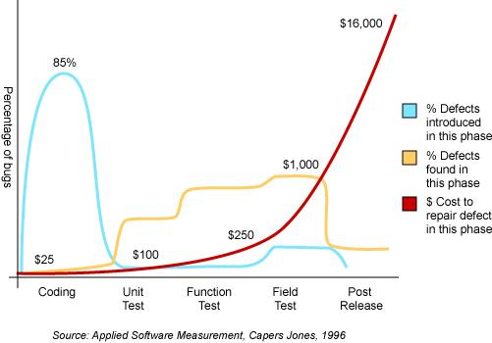
Why bad code is bad

Slide 7
Why bad code is bad - Example
You are apart of a team that is working on a new app.
Over the first year the team is moving fast creating new code with limited bugs. As the project continues members of there team leave and other developers have to maintain the code of another programmer slowing the development down. The team finds that every change they make to the code breaks two or three other parts of the code. No change is trivial. Every addition or modification to the system requires every ounce of code to be understood. Due to deadlines and pressing management the code is written becomes more and more convoluted. The mess becomes so big it can no longer be clean it up.
The above example reduces productivity of the team increasing the pressure from management. As pressure intensifies productivity continues to decrease.
Management higher more staff to increase productivity but the code has become so bad there is no hope. This cycle continues driving the productivity ever further toward zero.

Slide 8
The rebellion
The pressure looms developers cant continue and the robot developer rebellion begins.
A tiger team is formed
A tiger team is a specialized, cross-functional team brought together to solve or investigate a specific problem or critical issue.
Developers are split between multiple projects and nothing is completed.
The world ends. The aliens only have the remains of died projects and lost hopes and dreams

Slide 9
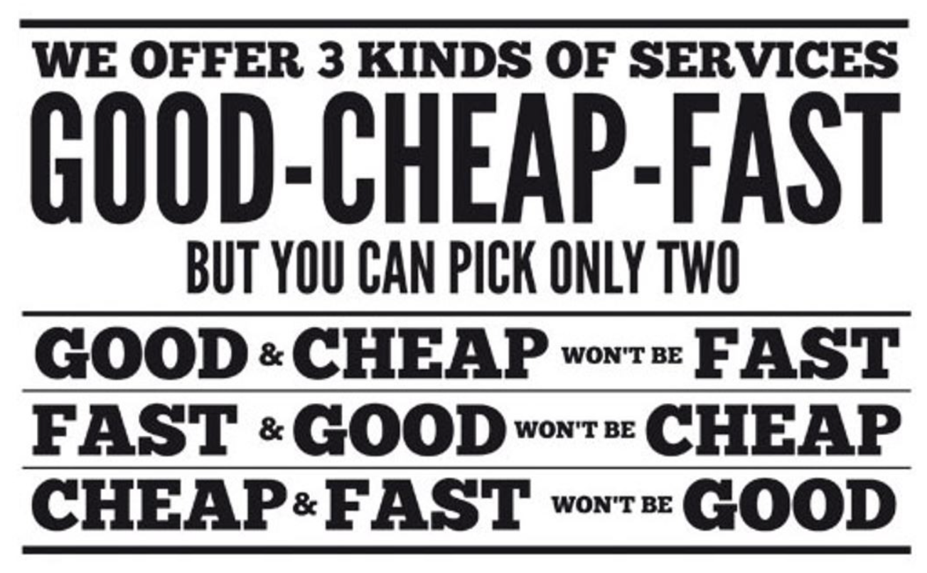
Code is an ART

Slide 10

Take the time to go fast!
To go fast you need take the time to make what you have beautiful.
The only way to go fast is to keep your code clean!
Writing code is an art you need to take time and plan the painting you are going to write. You first sketch out what you want to do. Then begin to add paint, then texture, then outlines. So on and so forth.
Unfortunately I can not paint a picture but I can tell you if
a picture is good or bad. (not great)

Slide 11
Bjarne Stroustrup, inventor of C++
“I like my code to be elegant and efficient. The logic should be straightforward to make it hard for bugs to hide, the dependencies minimal to ease maintenance, error handling complete according to an articulated strategy, and performance close to optimal so as not to tempt people to make the code messy with unprincipled optimizations. Clean code does one thing well.”

Slide 12
Ok enough of that

Slide 13
You are not just an artist but an author
What does an author do? They create stories that others read.
As an author you are responsible for communication to the reader.
Each line of code you need remember people will be reading it.
How much of your code will be read?
Think about it this way how many times did you read your code?
Fun fact: In the 80’s editors would keep track of every keystroke and play back your whole session in time time laps.
What was learned was a majority of the time was dedicated to scrolling and navigating to other lines of code.
The ratio of time spent reading vs. writing is well over 10:1

Slide 14
Intention-Revealing Names
One of the most important parts of code is relevant names.
Bad
int d; // elapsed time in days
Good
int elapsedTimeInDays;
int daysSinceCreation;
int daysSinceModification;
int fileAgeInDays;
Notes:
The name d reveals nothing
Choosing names that reveal intent can make it much easier to understand and change code. What is the purpose of this code?

Slide 15
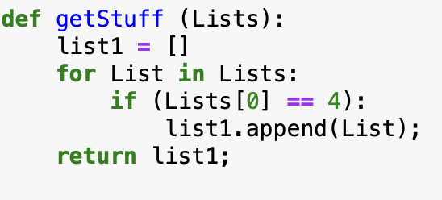
What is the code doing?
What kinds of things are in List?
What is the significance of the zeroth subscript of an item in List?
What is the significance of the value 4?
How would I use the list being returned?
The answer is: Who knows?

Slide 16
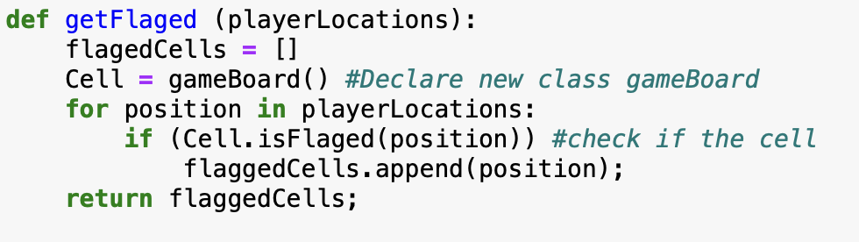
Now Lets take a look at the same code but with a few motifications

Slide 17

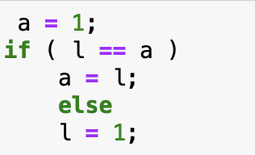
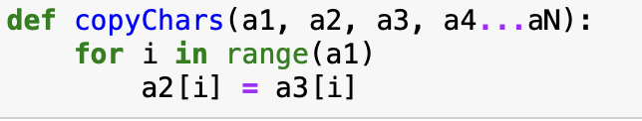
Dis-Information

Slide 18
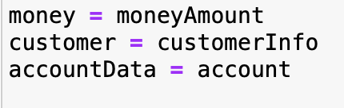
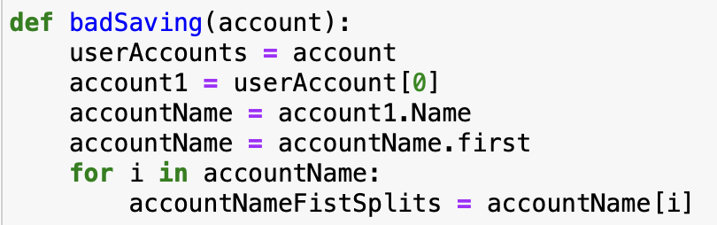
Noise

Slide 19
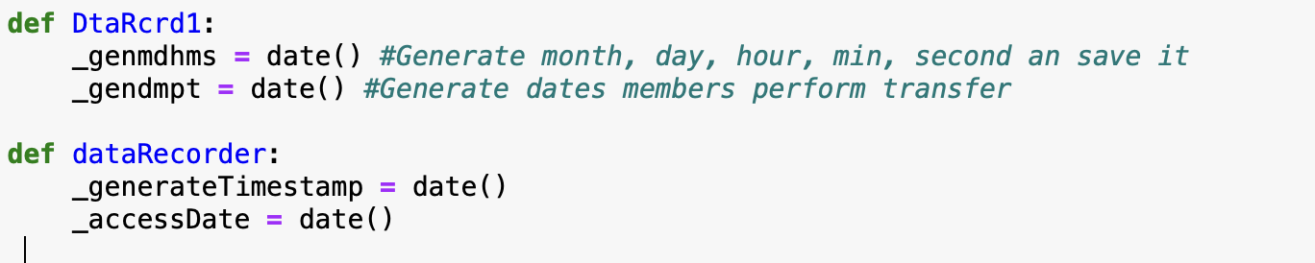
Pronounceable Names
If you can’t pronounce it you, can’t communicate
Think about asking others about this code.
”Hey, Bill, genmdhms is set to the wrong day. ”
”Hey, Bill, the accessDate is a month in the future”

Slide 20
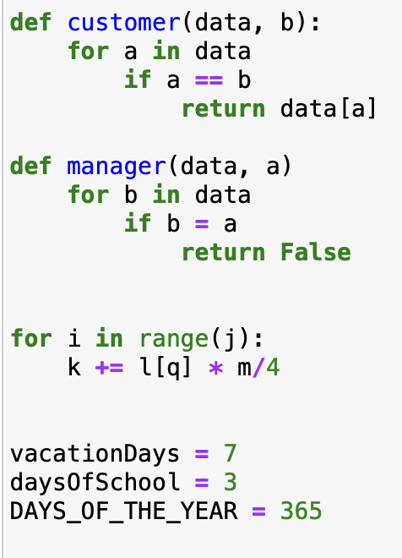
Searchable Names
The pro to a name you can’t pronounce is it is most likely unique. But a single letter “a” is not search able (think about always using ”a” in your functions
If you used data for every input of your functions think about how hard it would be to find data in your code

Slide 21
Variable name conventions to avoid
Encoding – keep names simple and reduce the burden of deciphering tbnfav #the best name for a variable
Hungarian Notation – prefixing variables with the type stringFirstName = ”Mr.”
Metal Mapping – using single letter names outside of very small scope (thing for loop). Single letter add unneded complexity
a = Address[1]

Slide 22
Naming Conventions
Class Names – Should be a noun or a noun phrase
AddressParser not data or info
Method Names – Should be a verb or Verb phrase
drone.takeOff() not drone.data()
When overloading the constructors should be clearly identified
wizard = Player(“name”, armor)
knight = Player(“name”, armor, weapon)
Don’t be Cute – While names should be cleaver humor is not the point of veriables. Cuteness in code is convoluted.
stuff, HolyHandGrenade

Slide 23
Most Important use meaningful context – New concept
We have not talked about context in this class as of yet.
What is Context
Functions name provide only part of a context, the algorithum provides the rest
Functions and methods are meaningful in themselves.
firstName, lastName, street, houseNumber, city, state, and zipcode. Taken together it’s pretty clear that they form an address.
What if you just saw the state variable being used alone in a method? Would you automatically infer that it was part of an address?
addFirstName, addLastName, addStreet, addHouseNumber…

Slide 24
Some bonus stuff not related to clean code

Slide 25
A staticmethod is a method that knows nothing about the class or instance it was called on. It just gets the arguments that were passed, no implicit first argument. It is basically useless in Python -- you can just use a module function instead of a staticmethod.
A classmethod, on the other hand, is a method that gets passed the class it was called on, or the class of the instance it was called on, as first argument. This is useful when you want the method to be a factory for the class: since it gets the actual class it was called on as first argument, you can always instantiate the right class, even when subclasses are involved.

Slide 26
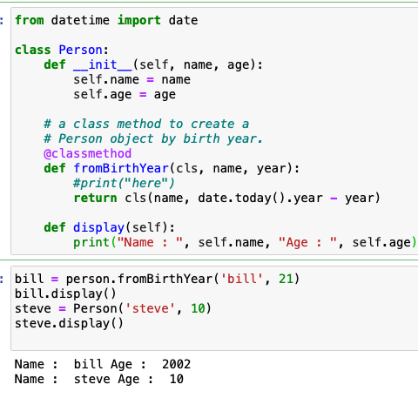

Slide 27
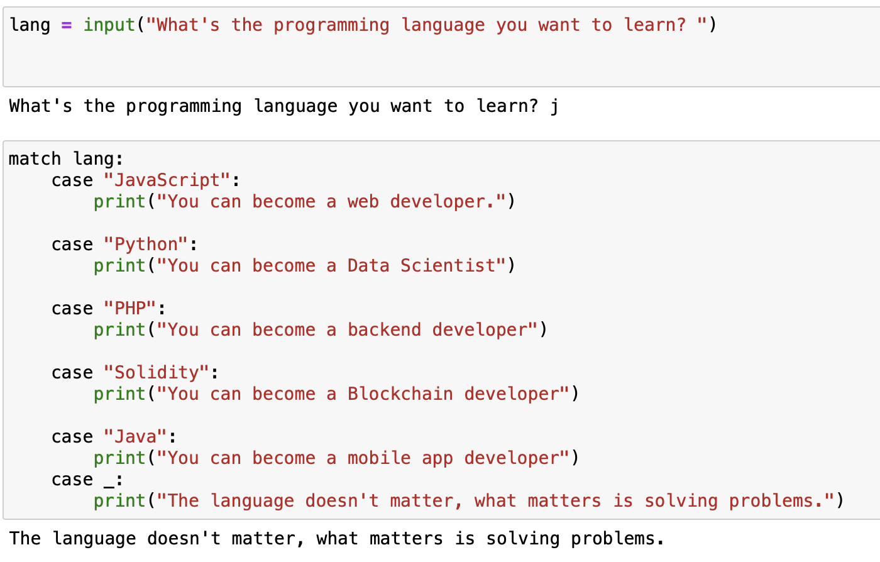
The following requires Python 3.10+

Slide 28
Resume regular programing

Slide 29
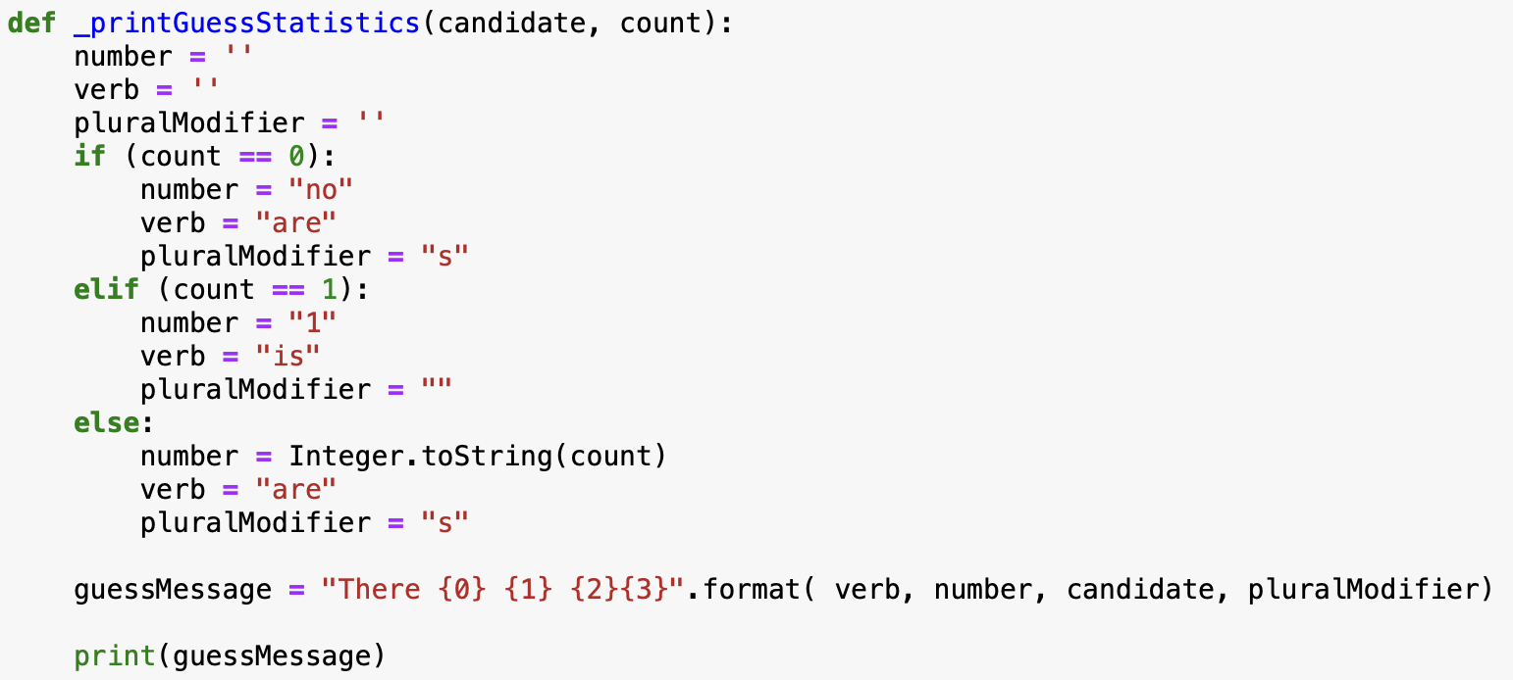
Lets take a look at two examples

Slide 30
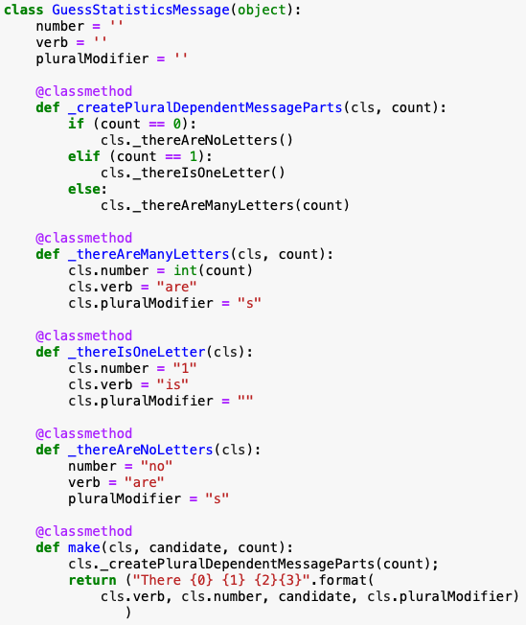
Split the function to provide more context

Slide 31
Functions

Slide 32
Think small
Functions should be small
Now remember functions should be smaller than that
Limit functions to 5 – 10 lines of code
Functions should do one thing. They should do it well. They should do it only
Functions should be transparently obvious
Do not over use if else while/for.
If you need to do multiples lines of these then these should be functions
If you can’t fit your operation into a operator then make it a function

Slide 33
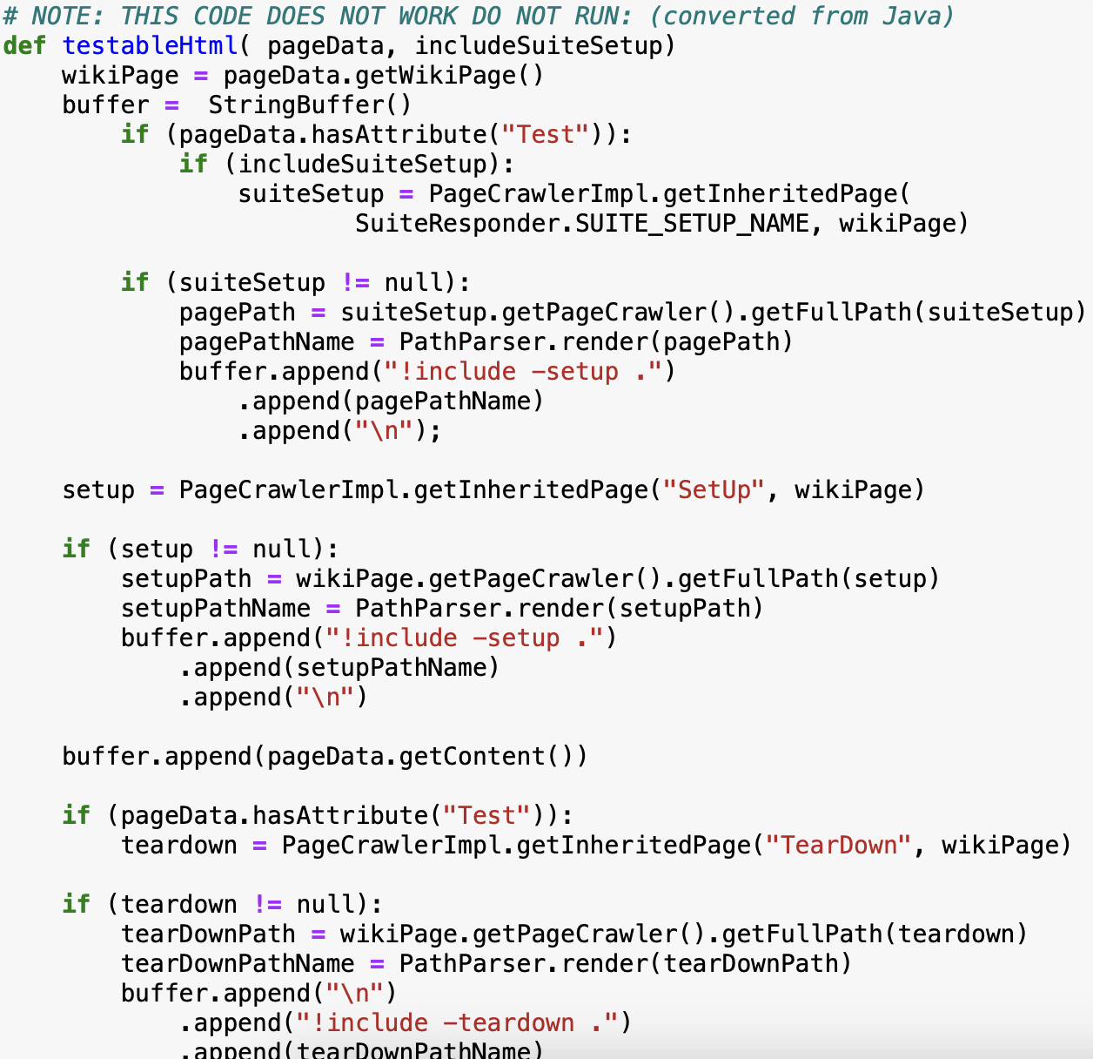

Slide 34
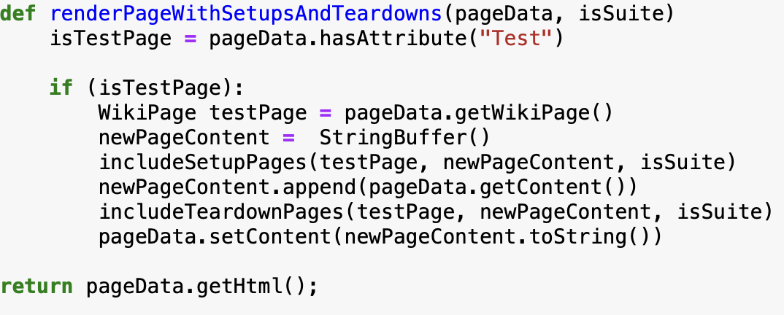

Slide 35
How do I know if it is small enough?
You should only do one level of abstraction per function.
Think baking a cake

Slide 36
Functions and args
Limit your functions to no more than 3 inputs
Functions that take three arguments are significantly harder to understand.
Limit argument lists or objects being pasted to 1
Limit the side affects of a function (doing other things)
In general return should be avoided.
If your function must change the state of something, have it change the state of its owning object.

Slide 37
Error Handling/Raising Errors (next class)
If a function is used to handle an error then that function should only do that.
When handing an error use a function to produce that error

Slide 38
Keep it DRY
Don’t repeat Yourself

